Slide 1

Team Galvatron: Content Aggregator
Tyler Nee, Tony Kong, Vickie Yen, Yuting Wen, Peter Han, David Guo, Pengwei Zhou
Notes:
Hi everyone,
We’re team Galvatron.
As i’m sure you know, our project is the content aggregator for Galvanize. And today, we’re going to be giving our project status updates.

Slide 2

Introducing the Team
Roles
Project Role | Name
Project Manager | Tyler Nee
UX/UI | Pengwei Zhou, Tyler Nee
Database | Vickie Yen
Technical Architect | Tony Kong
QA | Peter Han, David Guo
DevOps | David Guo
Frontend | Peter Han, Yuting Wen
Backend | David Guo, Tony Kong
Notes:
1min Everyone: So to start off, we want to give an overview of our team and our respective roles. Our team uses slack for our main form of communication and we also meet once a week to discuss any important issues and making design decisions. The role don’t mean that the people listed are the only ones who are performing the roles, but just simply the “lead” person. Without further a due, I’m Tyler.

Slide 3
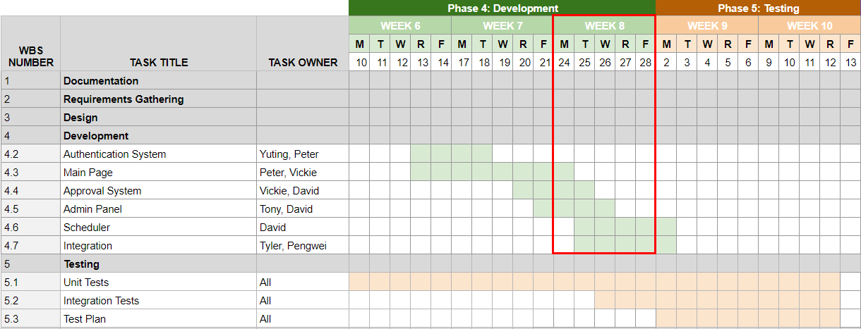
Project Plan
Notes:
2min, Tyler
So in terms of our project plan, we are currently in week 8. Based on our previous plan, we were very ambitious and we thought we would be finished our authentication system and most of the development work by this week. Definitely not the case and we soon realized this as we were preparing for the presentation. So we went back and revised on plan to stretch the development time as well as testing from now until April. That being said, the application is now deployed on AWS which was earlier than we anticipated and we are working through our tickets and bugs at a steady pace. We’re still getting used to our team dynamics so by mid-March we hope to find an optimal team rhythm.

Slide 4

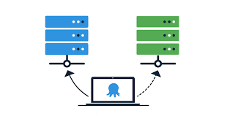

Project Status Update
Progress
Environment and Deployment
Kanban Board and Task Breakdowns
Current State of Application
Notes:
David: 3min
Environment & Deployment
1. We are deployed to an EC2 instance on AWS. Using linux, based on centOS. Running the applications under nodejs, and using mysql as db.
2. Team members are not very familiar with deployment. Learning as we go from online tutorials and videos.
3. Using systemd to start the client and server application as services.
helpful logging info
if program crashes, will try to automatically restart the application
4. Re-deploying is done through a bash script or manually if an error is encountered.
5. Have incorporated configuration files to differentiate between dev and production environments. Automatically switches to correct config based on environment.
=====
Jira
Task breakdown
Kanban boards visually display the various tasks and stories.
Allows us to assign tasks to individuals.
Allows us to keep track of current progress. Group various tasks together. Keep track of priority.
Allows us to clearly see what has been done, what’s currently in progress, and what’s in the backlog and needs to be worked on.
Keeps us organized and makes it clear to see who is responsible for various parts of
====
Progress
Frontend, backend, db set up and running.
Most UI functionality have been mocked up or completed.
Client successfully communicate with backend, is calling the API for a couple of the endpoints. Some endpoints are retrieving from db, some are returning mock data.
Frontend: most of the major pages have been worked on, except for Settings page.
Successfully integrated Google OAuth as a way to login to the application.
UI styling has yet to be done.
Changing our design as we go. Currently trying to incorporate sponsor feedback about database design

Slide 5
Current Challenges
1 - Finalizing Data Design
2 - UX Design
3 - Authentication Implementation
4 - Deployment
Notes:
Tony: 3min
I will be talking about the current challenges that our team is running into.
Our first problem is finalizing the data design. During our development time we found that some our data tables needed more or less columns or ran into situations like we needed an additional table to store information that we didn’t think of ahead of time. Like the user table didn’t require information such as an password or username field, or needing a table to store our settings. We couldn’t accurately assess these problems ahead of time due to not having as much experience with integrating our data with the rest of the application.
2. No one on our team has prior experience with UX, so we have lots of different ideas of how the UI can be lay out but lots of them are end up unintuitive for users or do not end up looking good. Examples of this can be found with not knowing exactly how much information we should be displaying with each post. For example users on the main page see when each post is published or who submitted each post? Such issues are hard to find solutions for because we don’t know what are good UX design practices.
3. Our third challenge is implementing authentication. While we are have our authentication partially implemented already, we anticipate having issues on the client side with managing what UI elements are visible to users. For example we only want approvers or admins to see unpublished posts and we don’t want normal users being able to access our pages to manage companies/categories. On the backend we anticipate challenges with checking user roles when checking who is using our API, for example we only want admins to be able to call the api to update user roles.
While we have already setup retrieving an access token from the google authorization server. And feel like we won’t run into too much challenges with the backend implementation. We need more research into how to manage each of the users sessions and the tokens we are issuing the users. We also need to look into how to hide parts of the UI depending on what the current user’s role is.
David: Deployment 30s
1. VM is not powerful enough, currently deployed on an instance with 1 GB memory and 1 vcore. CPU usage spikes to 100% when deploying.
Hard to support 1000 or more concurrent users.
2.

Slide 6
Major Changes
Updated Requirements
Data Design
UI Layout
Notes:
2mins Peter:
We also made some API changes because the data design changed
We are also going to add a table to keep track of each posts’ approvers so no user can approve the same post more than once
This new change is also going to be integrated into our content cards so for each admin/approver they can see which posts have been approved by them.
We added OAuth, RSS, blog streams
We also added an admin panel to control the blog stream and scheduler period. The admin will have the right to approve or delete blog stream under the blog stream page. They can also change the scheduler period under the setting page.
Pending post section is merged with published post sections: before, on our main page, we had two columns, for all users they can see all the approved posts on the left hand side and the admin/approvers can see all the pending posts on the right hand side. Since they have similar functionality we decided to merge them into one section. The admin and approvers will have the option to approve posts in blue, the admin can also delete posts in blue and white, blue posts are unpublished posts, white posts are published posts, and the user will only see the posts in white without any administrative power.

Slide 7
Demo Time
Notes:
2min Yuting
Home page:
1. all posts (published/unpublished) aggregated together with different colors, using pagination to reduce loading time
2. user use search-filter bar
3. user submit post using pop-up
3. approvers can approve (delete?) a post
Admins go to other tabs through dropdown
1. User Management: admin, approver, user aggregated, admins are able to edit/delete other approvers/users, search
2. Categories: add/search/delete
3. Companies: add/search/delete

Slide 8
Next Milestones
Test Plan and Delivery
Functional Backend: Database, API Endpoints, RSS and Scheduler
Main UI Components with Authentication Setup
Notes:
1min Pengwei
-fulfill functionality of all ui component
-web design(UX design)
-set up authentication system(admin&normal user)
-building API
-integrate datai(design)
-implement RSS for reading blog stream, scheduler
-unit test,integration test

Slide 9
Sponsor Support
Questions:
Does UI layout for admin page and main page look ok?
For admins/approvers, we display the unpublished posts on the main page and unpublished blog streams on an admin page for approval. Is this ok?
Under the admin settings should we have a setting to update the scheduler frequency? i.e. Email with new posts now gets sent every other day, or we now scan blog streams every hour.
When submitting posts/streams users are allowed to specify the company associated with the post, is this way of associating posts with companies okay? Or should posts be associated directly with an user’s registered company.
Notes:
Tony:
Questions:
- Does UI layout for admin page and main page look ok?
- For admins/approvers, we display the unpublished posts on the main page and unpublished blog streams on an admin page for approval. Is this ok?
- Under the admin settings should we have a setting to update the scheduler frequency? i.e Email with new posts now gets sent every other day, or we now scan blog streams every hour.
- When submitting posts/streams users are allowed to specify the company associated with the post, is this way of associating posts with companies okay? Or should posts be associated directly with an user’s registered company.

Slide 10
Q & A

